Slide 1
Libraries / Frameworks
Intro to ReactJS
access101

Slide 2
Let’s start with a question…
How do you prepare for the exams?
access101
Notes:
So how do you prepare yourself for the exams.
I mean, what are the materials do you use

Slide 3
Options….
Notes, Textbooks, Web, Sunstar
access101

Slide 4
Let’s introspect…
Notes (most common) 80%
Sunstar (backbenchers like me) 10%
Textbooks (geniuses like Salman) 5%
Web (duh…) 5%
access101
Notes:
So let’s introspect one by one

Slide 5
Why Notes account for 80% ?
Let’s come back here in few mins…
access101
Notes:
- Because notes is solid resource put

Slide 6
Libraries / Frameworks
access101

Slide 7
Question…
Can’t we build web apps without libraries / frameworks?
access101

Slide 8
Answer…
Yes. But… It comes with it’s own complexities and it’s imperative.
access101
Notes:
There will be problems you’ll be facing by building web apps with bare bones using JS
The problems which you’ll be facing has already been faced by lot of other people.
It’s imperative.. consider Dom.

Slide 9
Imperative vs Declarative
access101
Notes:
Does anyone knows what is imperative paradigm / Declarative paradigm?

Slide 10
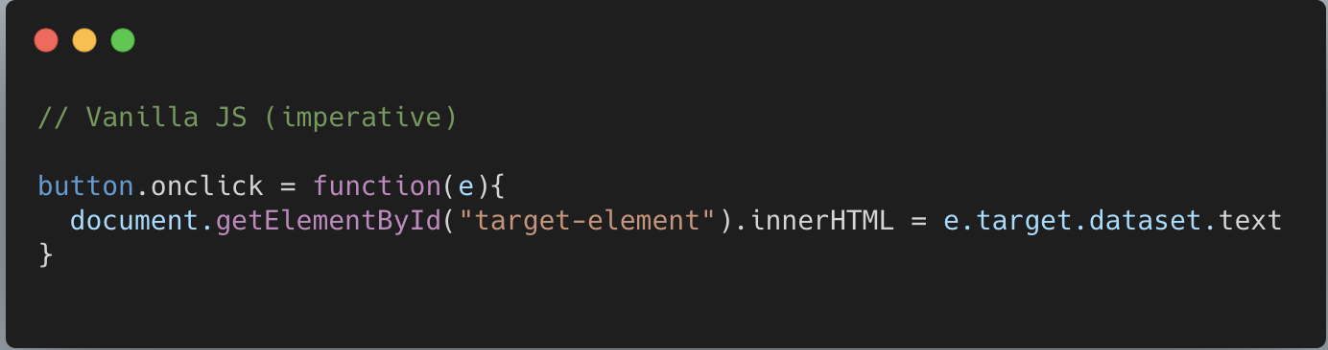
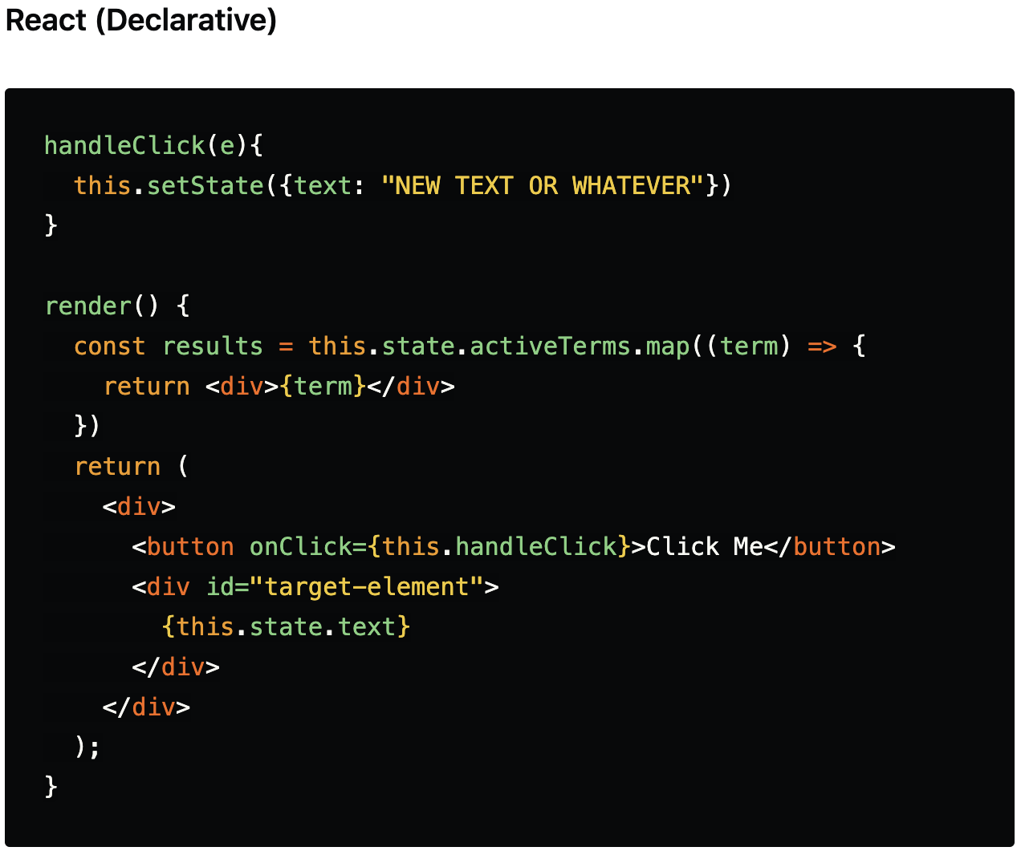
access101
Notes:
DOM is imperative because if we need to make a single change then we need to target that element, then change it
Another example of imperative is SQL queries
Most of the frontend frameworks are declarative

Slide 11
Libraries / Frameworks
It's an established piece of code that takes care of a lot of the grunt work in building a Web application so you can focus on the important pieces rather than re-inventing the wheel.
access101
Notes:
Example notes is the library or framework
Text books are bare bones

Slide 12
Mapping our analogy
Textbooks - HTML / CSS / Vanilla JS
Notes - Library / Framework
access101
Notes:
Example notes is the library or framework
Text books are bare bones
There will be question like there are many frameworks like angular / react / cue

Slide 13
Intro to React.
React is a UI library developed and maintained by facebook.
access101
Notes:
While using any open source library / framework we should have to put a lot of trust.
Some companies like oracle / juniper make there own framework

Slide 14
Getting started with React.
access101

Slide 15
Prerequisites
HTML5
CSS3
Javascript
ES6
access101

Slide 16
Features of React
Blazing fast as it uses virtual DOM
Component structure
Boosts productivity of the developer
Easily to jump on react-native
access101

Slide 17
ReactDOM & JSX
access101

Slide 18
Props in react
props is a special keyword in React.
Used for passing down data from one component to another.
props data is read-only.
access101

Slide 19
Array helper methods
Map will loop through each item of array, same like forEach but Map returns the value of the array.
Filter will return array based on the boolean of the comparison.
Find will return the record if a particular element is found in the array.
Reduce will is the most flexible helper, we can probably reimplement all the other helpers by just using reduce.
access101

Slide 20
State in react
State is a built in object in class components.
State object change triggers component re-render.
State is mutable.
access101

Slide 21
Modular Export
Named export means the key should have name . Hence a "named" export lol 😂.
With a Default export, you don't need any name. Because you can name it whatever you want
access101

Slide 22
Lifecycle of Components
The three phases are: Mounting, Updating, and Unmounting.
Mounting Phase: Mounting means putting elements into the DOM.
Updating Phase means is when a component is updated.
Unmounting Phase means when a component is removed from the DOM.
access101

Slide 23
1.Mounting
Mounting means putting elements into the DOM.
Constructor() method is called before anything else, when the component is initiated.
render method is required, and is the method that actual outputs HTML to the DOM..
componentDidMount method is called after the component is rendered..
access101

Slide 24
2.Updating
Mounting A component is updated whenever there is a change in the component’s state or props.
render method method is required and will always be called.
componentDidUpdate method is called after the component is updated.
access101

Slide 25
3. Unmounting
componentWillUnmount method is called when the component is about to be removed from the DOM.
access101

Slide 26
Introducing RESTful API
(a.k.a REST API)
access101

Slide 27
Full stack application - Early days
Full Stack app
Frontend
HTML / CSS / JS …
Backend
Layer to communicate with DB
Database (ex- MySQL)
access101

Slide 28
Full stack application - Nowadays
Full Stack app
Frontend
Backend
HTML / CSS / JS
Reactjs Angularjs
Layer to communicate with DB
Database (ex- MySQL)
access101

Slide 29
HTTP Methods - Conventions (rules)
GET - Retrieves data from server
POST - Posts data to the server
PUT / PATCH - Updates the record
DELETE - Deletes the record
access101

Slide 30
HTTP - Error codes
4XX - 400, 401, 404… - Client side errors
5XX - 500, 501, 502… - Server side errors
3XX - 300, 301, 302… - Redirection
2XX - 200, 201, 202… - Success
1XX - 100, 101, 102… - Informational
access101

Slide 31
Let’s simulate
POST - /login - wrong credentials
Response - 404
POST - /login - right credentials
Response - 200 - token
Client
Your device
Server
linkedin.com
GET - /home - token
Response - 200 - data
GET - /home - token
Response - 500
access101

Slide 32
Promise and Fetch
access101

Slide 33
Promise
A promise is an object that may produce a single value some time in the future.
It has 3 states
Resolved
Reject
Pending
access101

Slide 34
Fetch
The Fetch API is a promise-based Javascript API for making asynchronous HTTP requests in the browser.
access101

Slide 35
Let’s build a news app…
access101

Slide 36
Announcement
access101

